Slide 1
I/O Tags
Studio 5000
© 2014 John Sefcovic.

Slide 2
I/O Tags
All I/O connections are Controller Tags.
Each I/O Base address should be given an Alias name.
Recommended practice and a common accepted practice.
A Base is the source of the data, an Alias uses the Base’s value
An Alias is a name assigned to a data entry to make it more convenient to locate or manipulate.
The use of an Alias:
Organizing the I/O data to mirror the machinery or process.
Documents the I/O in the application as it is developed.

Slide 3
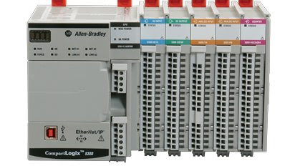
I/O Tags
Data sent to the PLC are Inputs and are “read” by the PLC.
Data originating at the PLC are Outputs and are “written” by the PLC.

Slide 4
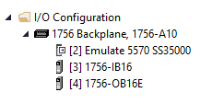
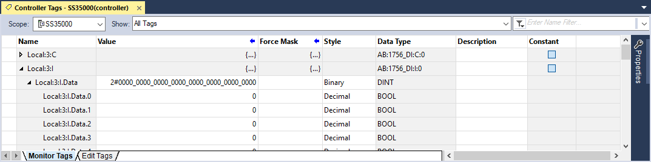
I/O Tags
1756-IB16 is the part number
In this example to Monitor Tags, the Input Module is in Slot 3.
By expanding the Local: (Location) 3: (Slot) .I (Type) .Data (Member) .num (Bit) the value can be viewed.

Slide 5
I/O Tags
The Base addressing format for Inputs and Output connections is:
name: slot.data.structure.bit
name | Local for chassis based I/O or communications adapter name.
slot | Location of the slot in the chassis or network data word.
type | I for input; O for output.
member | Data, Fault, or Configuration. I/O terminations are Data
bit | Memory bit associated with I/O terminations/data

Slide 6
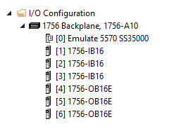
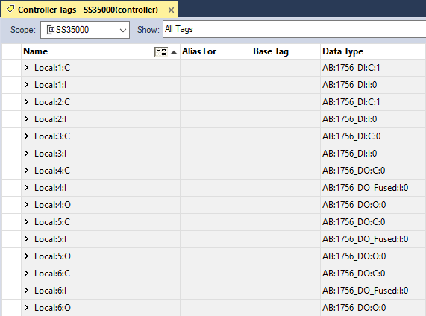
I/O Tags
Application Controller Tags
Input Modules
In this example, the Input modules are located in Slots 1, 2, and 3 of the Local chassis.
Output Modules
The Output modules are located in Slots 4, 5, and 6 of the Local chassis.

Slide 7
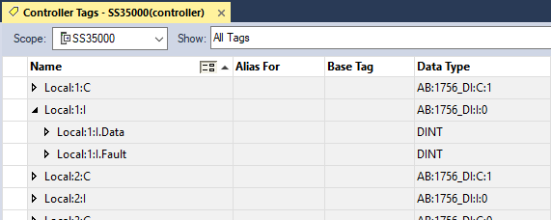
I/O Tags
Application Controller Tags
When the Input for slot 1 is expanded, the Fault and Data Structures associated with the module can be seen.

Slide 8
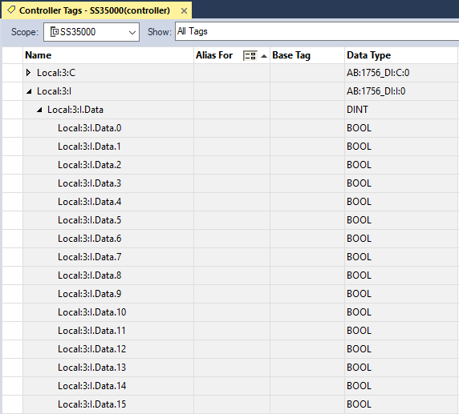
I/O Tags
Application Controller Tags
When the Data structure is expanded, the 16 data bits (0-15) of the 16 terminations on the Input module are displayed.

Slide 9
I/O Tags
Application Controller Tags
The Fault structure is dependant on the model of the input module.
An unformatted fault code is written to the structure.
A formatted view of the fault with the code and description of the fault can be viewed in the modules Properties dialog.

Slide 10
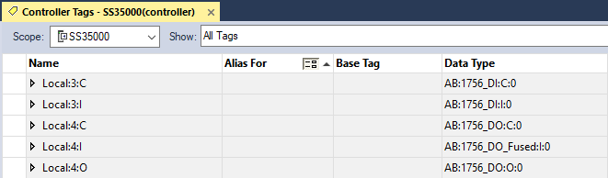
I/O Tags
Application Controller Tags
In this example for slot 4, the Configuration, Input Fault and Data Structures associated with the module can be seen.

Slide 11
I/O Tags
The Configuration structure format is dependant on the model of the module.
For example, the Output module Local:4:C can be configured for the output termination to remain in the last state of if there is a processor Fault or the processor mode is switched to Program.
The configuration information is written to the module. memory.

Slide 12
I/O Tags
The Output module Local:4:I Input is information read from the Module by the Processor. The structure’s format is dependant on the model of the output module.
For this type of module an unformatted fault code is “read” into the processor's memory when the module’s fuse is blown.

Slide 13
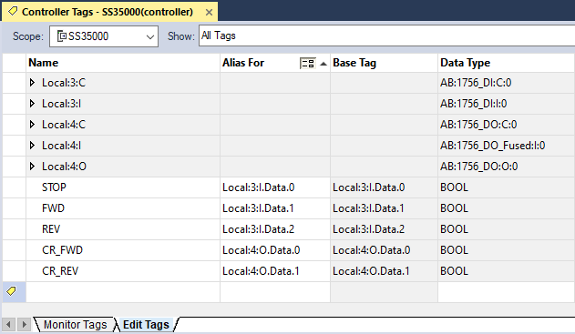
I/O Tags
Controller Tags I/O Hardware Address
An Input module is in Slot 3.
The Output module is in Slot 4.

Slide 14
I/O Tags
A Name is defined for each Output and Input for the module’s Hardware Address termination .
Tag Names
Which is the Base Tag or source of the data.
The Alias for the Name is associated with the module’s termination data bit.

Slide 15
I/O Tags
Tag Names
Notice the Data Type is BOOL or Boolean, single bit, for the Off or On status of the I/O.

